Slide 1
Aroga Referrals and Health Analytics Forecast

Slide 2
Aroga Referrals Forecast

Slide 3
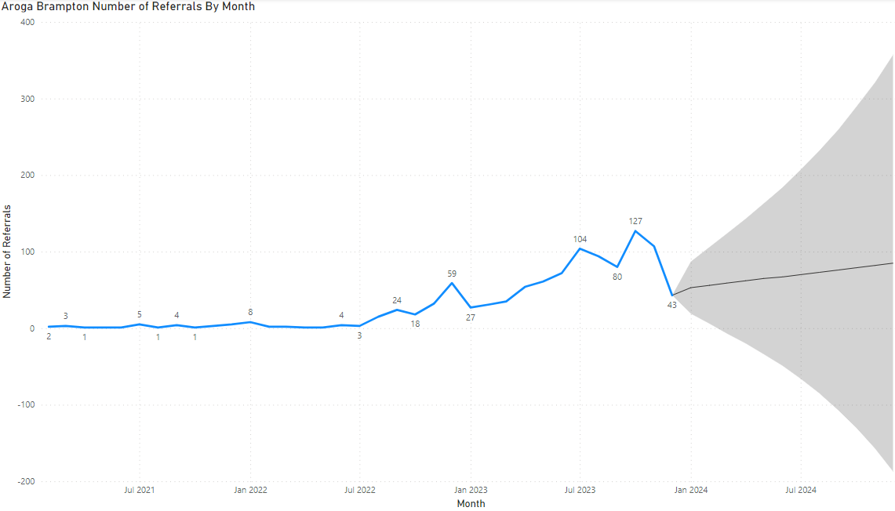
Count of Aroga Brampton Referrals by Month

Slide 4
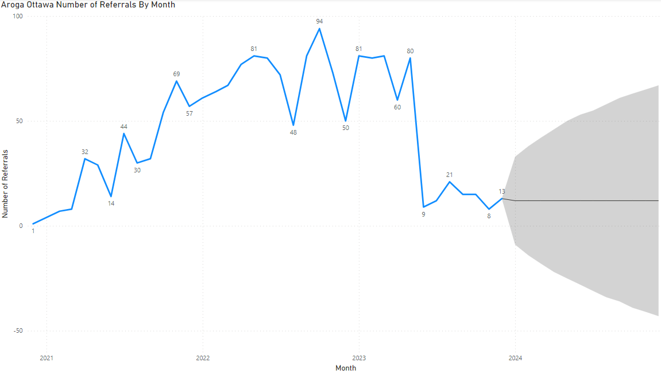
Count of Aroga Ottawa Referrals by Month

Slide 5
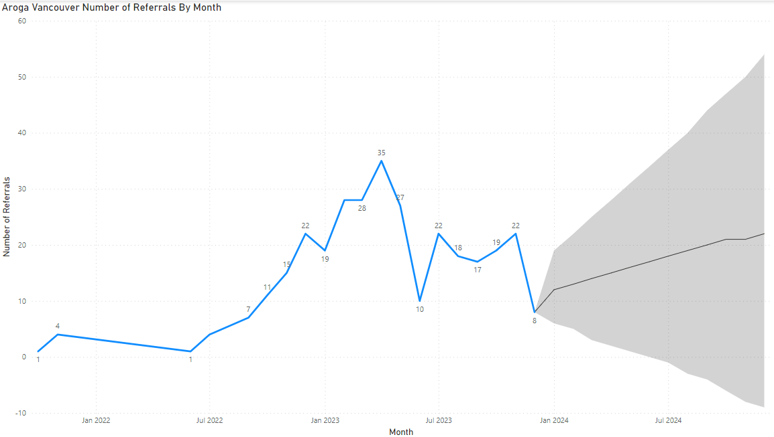
Count of Aroga Vancouver Referrals by Month

Slide 6
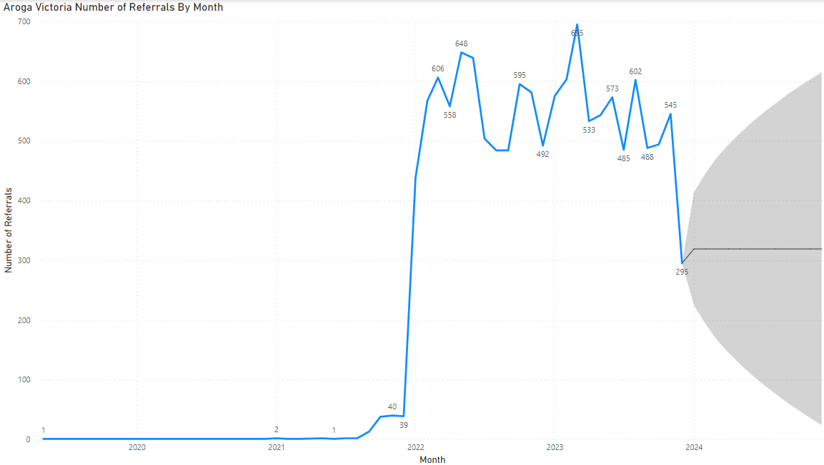
Count of Aroga Victoria Referrals by Month

Slide 7
Projected Aroga Referrals
Aroga Clinic | December 2023 Referrals | December 2024 Projected Referrals
Aroga Brampton | 43 | 85
Aroga Ottawa | 13 | 12
Aroga Vancouver | 5 | 22
Aroga Victoria | 295 | 319

Slide 8
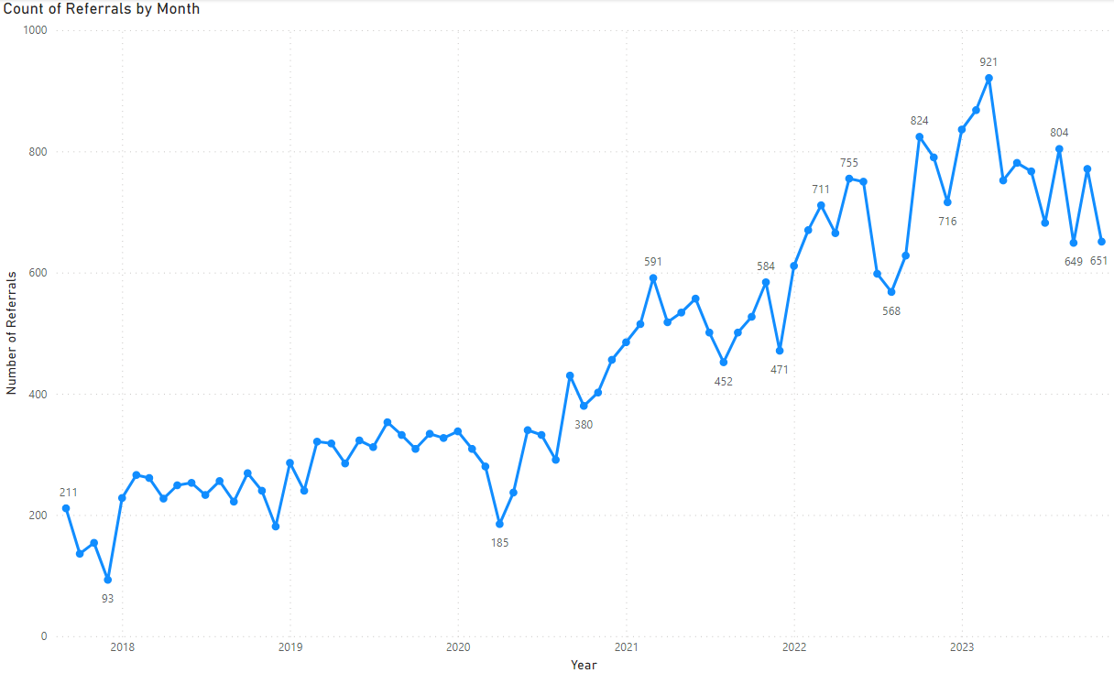
Count of All Aroga Referrals by Month

Slide 9
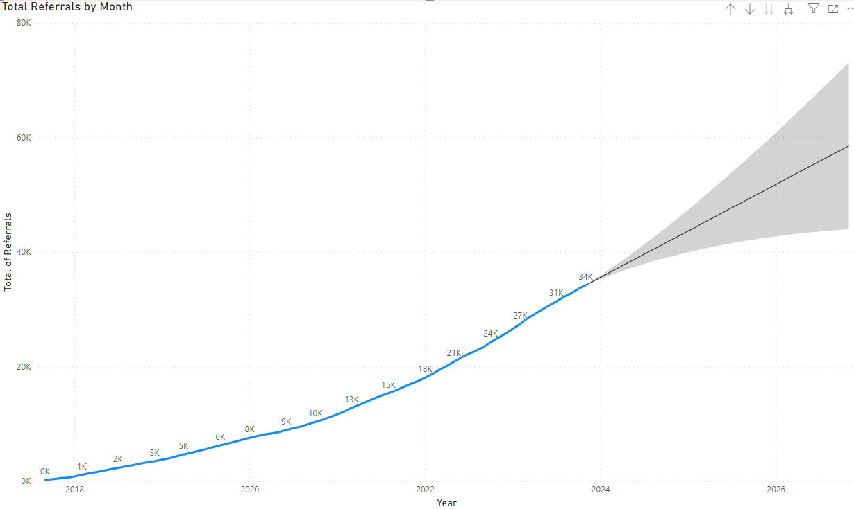
Total Aroga Referrals Forecast by Month

Slide 10
Aroga Health and Medicine Analytics

Slide 11
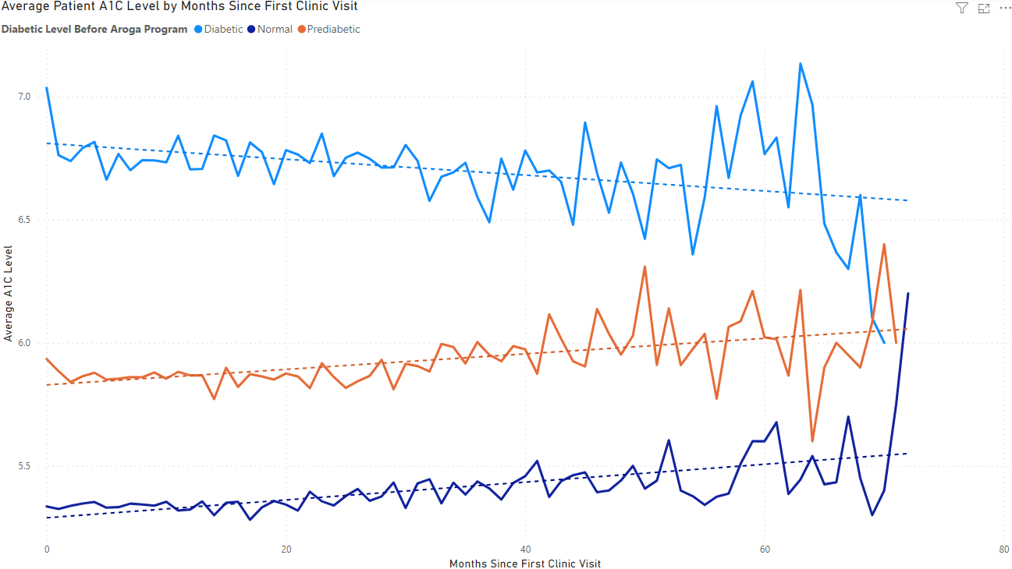
On Average Diabetic Aroga Patients Decrease Their A1C Levels by 4% Within 6 Years

Slide 12
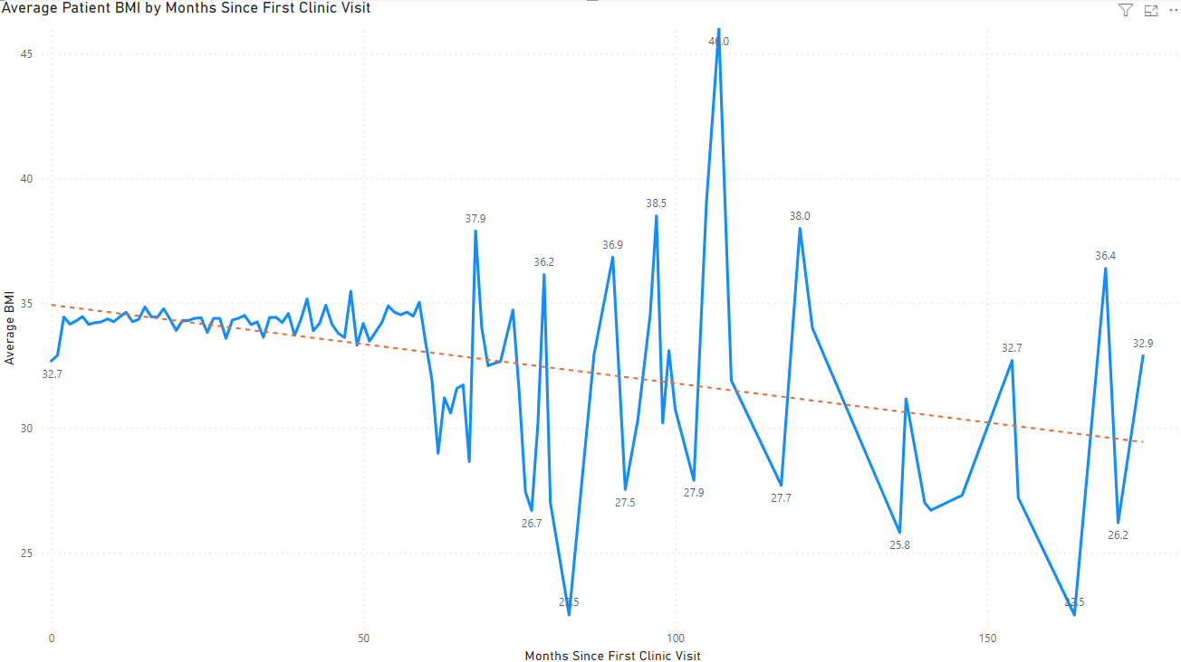
On Average Aroga Patients Decrease Their BMI by 7% Within 5 Years and 11% Within 10 Years

Slide 13
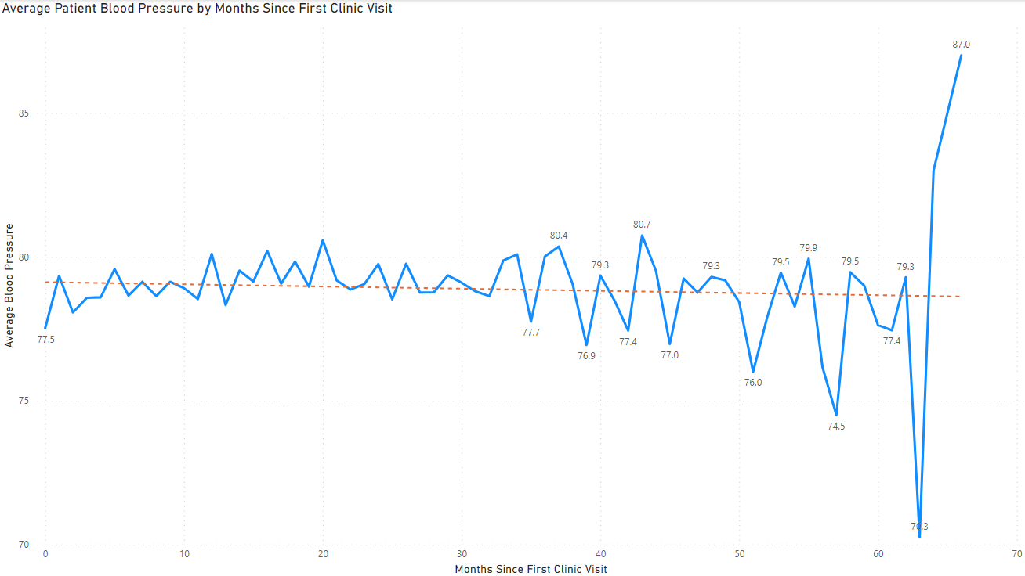
On Average Aroga Patients Will See a Steady Decrease In Blood Pressure After 2.5 Years With Aroga

Slide 14
Before Joining Aroga, 95% of Patients Have a Prescription That Lasts More Than 3 Years
After Joining Aroga, 95% of Patient’s Prescriptions Lasts Less Than 2 Years
95% of Aroga Patients Have Their Prescriptions Ended 2 Years After Entering the Program

Slide 15
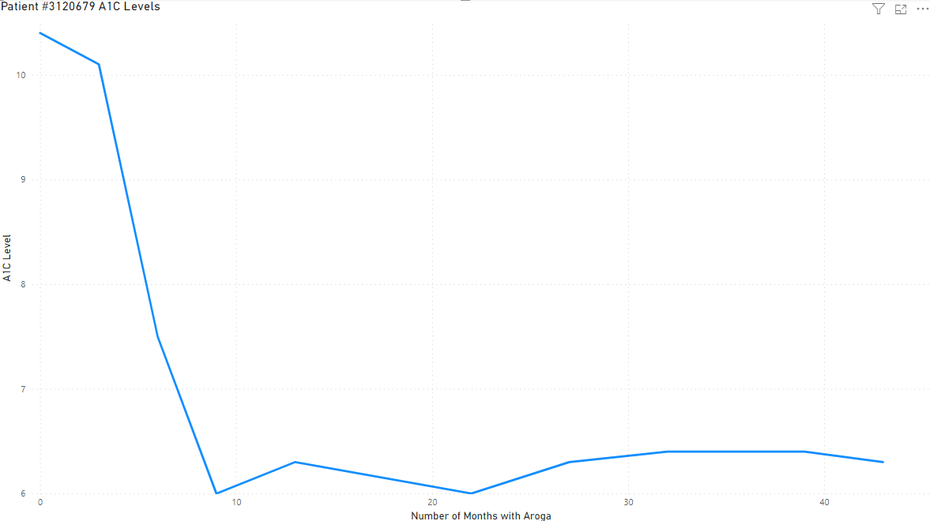

Aroga Patient ID #3120679 A1C Levels
Patient #3120679
Age: 56

Slide 16
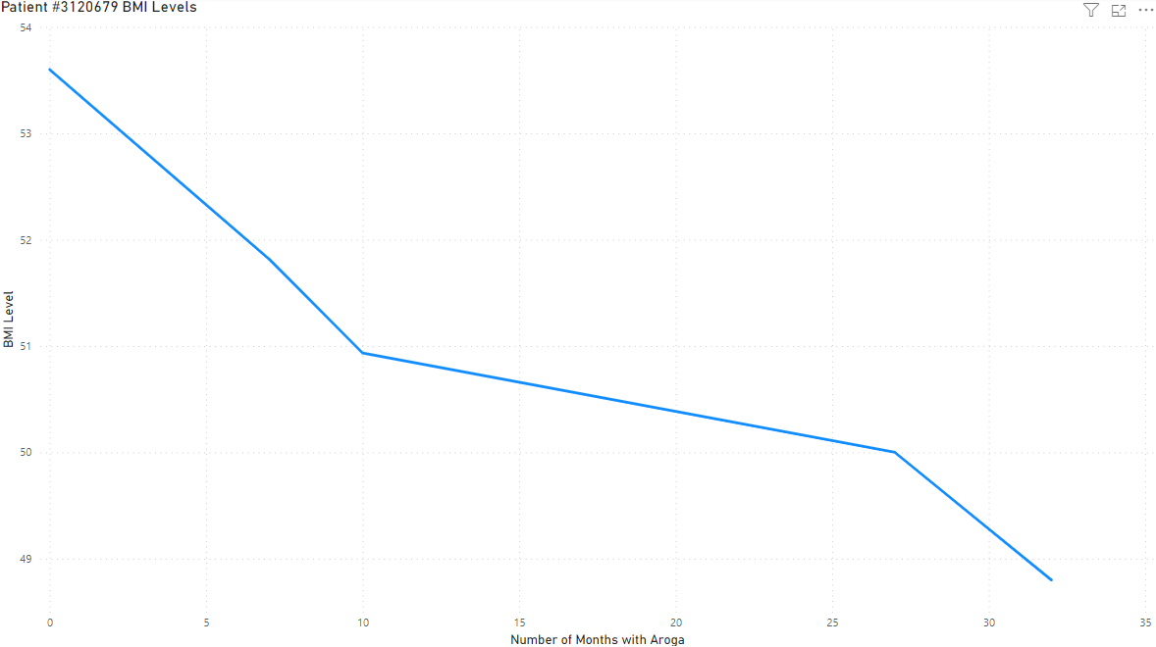
Aroga Patient ID #3120679 BMI Levels
Patient #3120679
Age: 56

Slide 17
Aroga Patient ID #3120679 Medication Data
Patient #3120679 Has Been Prescribed Once Since Joining Aroga
Patient #3120679
Age: 56
Drug Name | Date Taken | Quantity
Ozempic | July 25th, 2019 | 1 Dose

